Slide 1
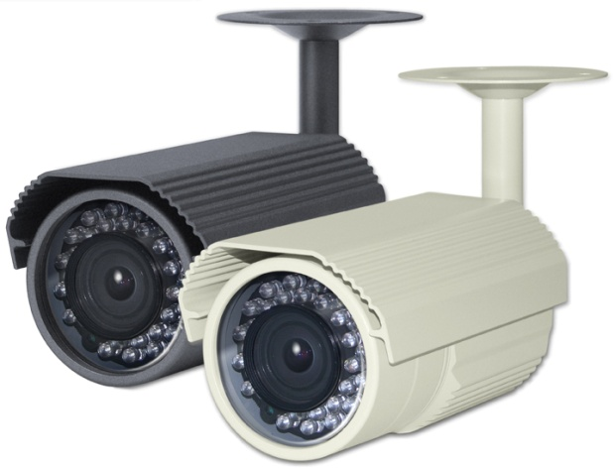
SPECIFICATIONS
MEMO
HD-SDI IR BULLET CAMERA
SDI-UL221IRV
USER’S MANUAL
Image Sensor
1/3” Sony CMOS(IMX138)
Total Pixels
1312(H) x 1069(V) = 1.4M (pixel)
Active pixels
1305(H) x1049(V) = 1.37M (pixel)
Scanning system
Progressive Scan
Resolution
Digital ; 1280x720p(720p/60fps)
Min. illumination
Color : 1.0 lux , BW : 0.5lux, Color DSS : 0.002 lux , BW DSS : 0.001 lux
S/N Ratio
more than 50dB (AGC off)
Video Output
HD-SDI, Analog : NTSC, PAL(without WDR)
BRIGHTNESS
0 ~ 20 steps
SHUTTER SPEED
Auto / Flicker / Manual (1/60(50)~1/6000)
SENS-UP
Off / x2 / x3 / x4 / x5 / x6 / x7 / x8 ~ x32
AGC
0~20 steps
DEFOG
On / Off
BACKLIGHT
Off / HLC / BLC / WDR
DAY&NIGHT
Auto / Color / B&W / Ext
WHITE BALANCE
Auto / Autoext / Preset / Manual
DNR
Off / Low / Middle / High
SHARPNESS
0 ~ 10 steps
SDI-UL221IRV
MIRROR
On / Off
FLIP
On / Off
D-WDR
On / Off
SHADING
On / Off
PRIVACY
On(16 Points) / Off
FEATURES
MOTION
On / Off
FRAME RATE
50FPS / 60FPS
• 1/3” Sony CMOS (IMX138)
• Digital : 1280x720p(720p/60fps)
• Min. Illumination of 0.001Lux(Sense-up x32)
• True Day & Night
• NTSC/PAL selectable
• Defog(Visibility enhancement on the low contrast scene)
• High resolution digital zoom (x8)
• 2D & 3D Digital Noise Reduction
• Flicker Suppression
• Motion Detection, Privacy Masking (16 Zone)
• 30pcs IR LED
• 2.8~12.0mm Megapixel ICR V/F Lens
• IP66 Weatherproof
• Option : RS-485 / OSD Controller
CVBS
NTSC/PAL
Language
ENG/CHN/JPN (Multi Language)
Lens
2.8~12.0mm Megapixel ICR V/F Lens
IR LED
30 pcs
Power Supply
DC 12V (±10%)
Power Consumption
LED Off : Max. 150mA / LED On : Max. 400mA
Operating Temperature
-10°C ~ +50°C
Operating Humidity
0% ~ 90%
Dimension
79.2(W) x 74.7(H) x 146.3(D)mm
Weight
Approx. 888g (W/ Sunshield & Bracket)
* In accordance with customers’ request and OSD controller’s option, the specifications can be fixed or changed without notice.

Slide 2
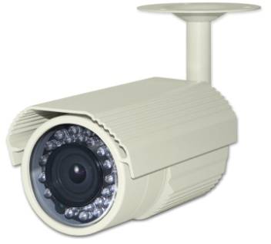
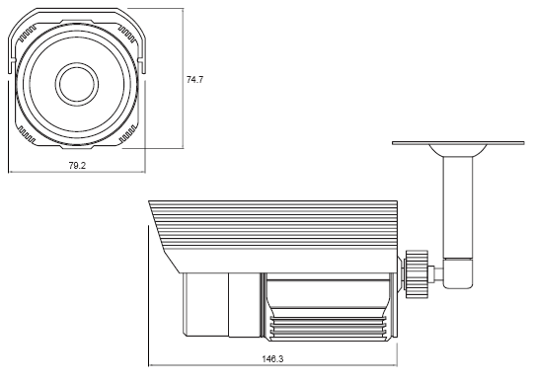
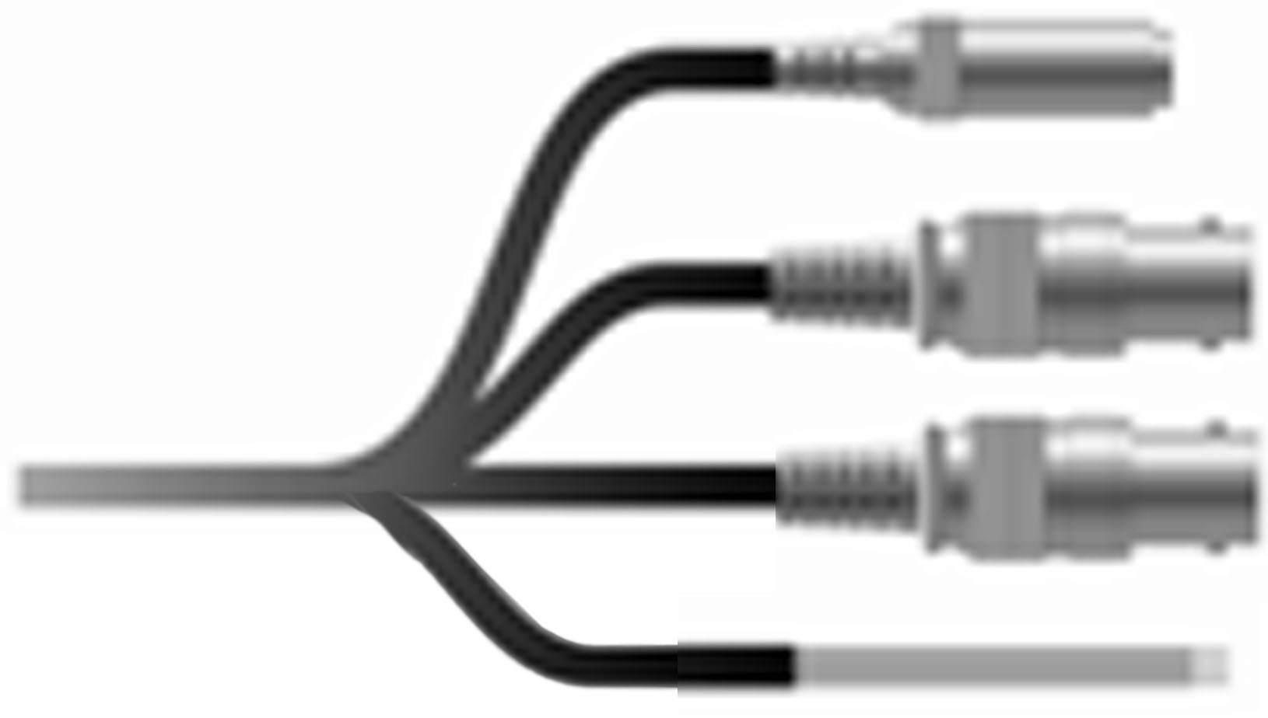
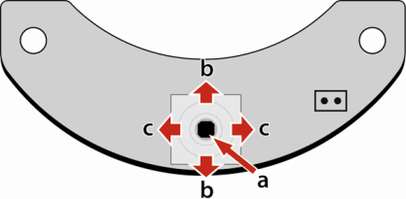
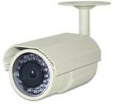

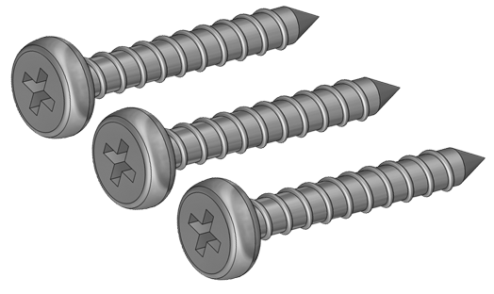
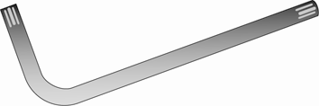
PRECAUTIONS
NAME OF EACH PART
DIMENSION
• Do not install the camera in extreme temperature conditions.
- Only use the camera under conditions where temperatures are between -10°Cand +50°C. Be especially careful to provide ventilation when operating under high temperatures.
• Do not install or use the camera in an environment where the humidity is high.
- It can cause the image quality to be poor.
• Do not install the camera under unstable lighting conditions.
- Severe lighting change or flicker can cause the camera to work improperly.
• Never use the camera close to a gas or oil leak.
- It can cause malfunctions to occur.
• Do not disassemble the camera.
- There are no user-serviceable parts inside it.
• Do not touch the front lens of the camera.
- It is one of the most important parts of the camera. Be careful not to be stained by fingerprint.
• Never keep the camera face to strong light directly.
- It can damage the image sensor.
• Do not drop the camera or subject them to physical shocks.
- It can cause malfunctions to occur.
• Do not expose the camera to rain or spill beverage on it.
- If it gets wet, wipe it dry immediately. Liquids can contain minerals that corrode the electronic components.
• Do not expose the camera to radioactivity.
- If exposed to radioactivity the image sensor will fail.
* NOTE *
• If the camera is exposed to spotlight or object reflecting strong light, smear or blooming may occur.
• Please check that the power satisfies the normal specification before connecting the camera.
Bracket
Lens
Sunshield
IR LED
Sensor
CABLE CONNECTION
Power input (DC 12V)
HD-SDI output
Video cable (Option)
Red : RS-485+ / Yellow : RS-485-
White : Motion output / Black : GND
(Option)
OSD CONTROL (Option- BOARD / CABLE)
Video loop-out
a
UP
L
DOWN
R
COMPOSITION
OSD Controller
a. SET :
Displays the menu on the screen. Press this switch to confirm status or after changing a selected item.
b. UP / DOWN :
Used to move the cursor up or down in the menu screen to select a desired menu item.
c. LEFT / RIGHT :
Used to move the cursor left or right in the menu screen or to change the value of the selected item.
Camera
Video cable
Power cable
Screw
L- Wrench
Manual

