Slide 1
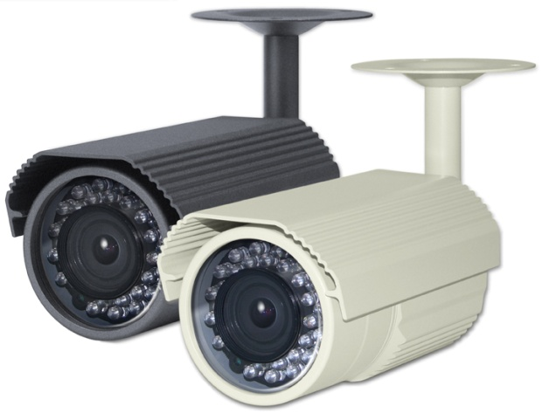
SPECIFICATIONS
MEMO
HD-SDI COLOR IR LED CAMERA
SDI-UL222IRV
USER’S MANUAL
Image Sensor
1/3“ 2.1Megapixel CMOS
Scanning System
Progressive Scan
Total Pixels
2010(H) x 1108(V)
Effective Pixels
1944(H) x 1092(V)
S/N Ratio
More than 50dB
Video Output Mode
1080P (1920x1080) 25P/30P
Video Output Level
HD-SDI / 1.0Vp-p (75Ω, Composite) NTSC/PAL (W/O WDR)
Min. Illumination
Color : 0.5Lux (B/W : 0.1Lux / Sens-up x8 : 0.02Lux)
Electronic Shutter Speed
AUTO / FLK
NTSC : 1/30~1/50,000sec
PAL : 1/25~1/50,000sec
White Balance
AUTO / AUTOEXT / PRESET / MANUAL
Backlight Compensation
BLC / HLC / WDR / OFF
D-WDR
ON / OFF
AGC
0 ~ 20
Day & Night
AUTO / BW / COLOR / EXT (Selectable)
DNR
OFF / LOW / MIDDLE / HIGH
Sens-up
ON / OFF (~ x8)
Motion Detection
ON / OFF
SDI-UL222IRV
Privacy Masking
ON / OFF (16 Zone Selectable)
Defog
ON / OFF
D-Effect
MIRROP / D-ZOOM / FLIP
Output Mode
720P / 720P CROP / 1080P
Frame Rate
1080P-25FPS / 30FPS , 720P CROP-50FPS / 60FPS
FEATURES
Language
English (Selectable)
OSD
Built-in
• 2.1M Pixel Progressive Scan Color CMOS Sensor
• 1944x1092@30fps
• Video Out (BNC) with NTSC/PAL Selectable
• Dual Output – Megapixel HD CCTV (BNC) and SD CCTV (BNC) out
• Defog (Visibility Enhancement on the Low Contrast Scene)
• Digital Zoom (x8)
• Sens-up (x8)
• Flicker Suppression
• DNR (2D & 3D Noise Reduction)
• DPC (Dead Pixel Compensation)
• 2 Auto (AE/AWB) Control
• HLC/BLC Support (High Light / Back Light Compensation)
• 30pcs IR with Mechanical Lens TDN(ICR) Motor
• Minimum IR Distance 30m
• 2.8~12.0mm Megapixel ICR V/F Lens
• IP66 Weatherproof
• Option : OSD Controller
Lens
2.8~12.0mm Megapixel ICR V/F Lens
IR LED
30 pcs
Power Supply
DC 12V (±10%)
Power Consumption
LED Off : Max. 200mA / LED On : Max. 400mA
Operating Temperature
-20°C ~ +50°C
Operating Humidity
0% ~ 90%
Dimension
79.2(W) x 74.7(H) x 146.3(D)mm
Weight
Approx. 888g (W/ Sunshield & Bracket)
* In accordance with customers’ request and OSD controller’s option, the specifications can be fixed or changed without notice.

Slide 2
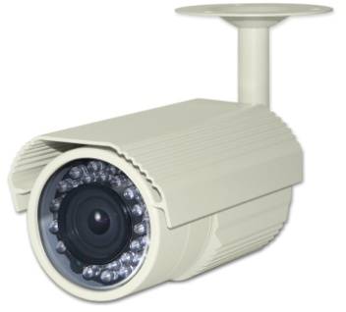
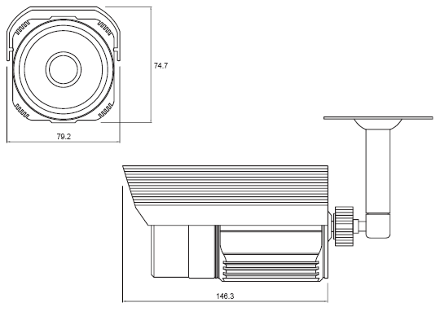
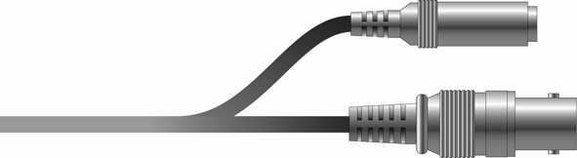
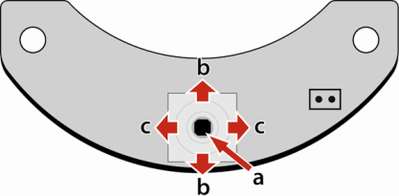
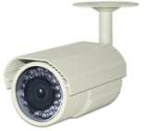

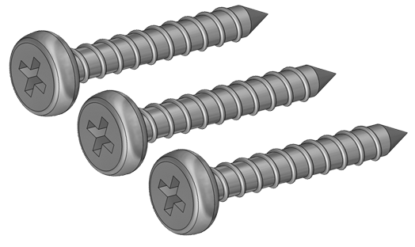
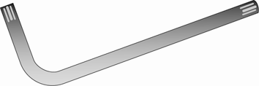
PRECAUTIONS
NAME OF EACH PART
DIMENSION
• Do not install the camera in extreme temperature conditions.
- Only use the camera under conditions where temperatures are between -10°Cand +50°C. Be especially careful to provide ventilation when operating under high temperatures.
• Do not install or use the camera in an environment where the humidity is high.
- It can cause the image quality to be poor.
• Do not install the camera under unstable lighting conditions.
- Severe lighting change or flicker can cause the camera to work improperly.
• Never use the camera close to a gas or oil leak.
- It can cause malfunctions to occur.
• Do not disassemble the camera.
- There are no user-serviceable parts inside it.
• Do not touch the front lens of the camera.
- It is one of the most important parts of the camera. Be careful not to be stained by fingerprint.
• Never keep the camera face to strong light directly.
- It can damage the image sensor.
• Do not drop the camera or subject them to physical shocks.
- It can cause malfunctions to occur.
• Do not expose the camera to rain or spill beverage on it.
- If it gets wet, wipe it dry immediately. Liquids can contain minerals that corrode the electronic components.
• Do not expose the camera to radioactivity.
- If exposed to radioactivity the image sensor will fail.
* NOTE *
• If the camera is exposed to spotlight or object reflecting strong light, smear or blooming may occur.
• Please check that the power satisfies the normal specification before connecting the camera.
Bracket
Lens
Sunshield
IR LED
Sensor
CABLE CONNECTION
Power input (DC 12V)
Video output (Connecting to monitor)
OSD CONTROL (Option- BOARD / CABLE)
Video loop-out
a
UP
L
DOWN
R
OSD Controller
a. SET :
Displays the menu on the screen. Press this switch to confirm status or after changing a selected item.
b. UP / DOWN :
Used to move the cursor up or down in the menu screen to select a desired menu item.
c. LEFT / RIGHT :
Used to move the cursor left or right in the menu screen or to change the value of the selected item.
COMPOSITION
Camera
Video cable
Power cable
Screw
L- Wrench
Manual

