Slide 1
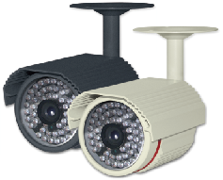
SPECIFICATIONS
MEMO
HD-SDI COLOR IR LED CAMERA
SDI-UL252IR
USER’S MANUAL
Image Sensor
1/3” 2.1Megapixel CMOS
Scanning System
Progressive Scan
Total Pixels
2010(H) x 1108(V)
Effective Pixels
1944(H) x 1092(V)
S/N Ratio
More than 50dB
Video Output Mode
1080P (1920x1080) 25P/30P
Video Output Level
HD-SDI / 1.0Vp-p (75Ω, Composite) NTSC/PAL (W/O WDR)
Min. Illumination
Color : 0.5Lux (B/W : 0.1Lux / Sens-up x8 : 0.02Lux)
Electronic Shutter Speed
AUTO / FLK
NTSC : 1/30~1/60,000sec
PAL : 1/25~1/50,000sec
White Balance
AUTO / AUTOEXT / PRESET / MANUAL
Backlight Compensation
BLC / HLC / WDR / OFF
D-WDR
ON / OFF
AGC
0 ~ 20
Day & Night
AUTO / BW / COLOR / EXT (Selectable)
DNR
OFF / LOW / MIDDLE / HIGH
Sens-up
ON / OFF (~ x8)
Motion Detection
ON / OFF
SDI-UL252IR
Privacy Masking
ON / OFF (16 Zone Selectable)
Defog
ON / OFF
D-Effect
MIRROR / D-ZOOM / FLIP
Output Mode
720P / 720P CROP / 1080P
Frame Rate
1080P-25FPS / 30FPS , 720P CROP-50FPS / 60FPS
FEATURES
Language
English (Selectable)
OSD
Built-in
• 1/3” Panasonic 2.1M Pixel Progressive Scan Color CMOS Sensor
• 1944x1092@30fps
• Video Out (BNC) with NTSC/PAL Selectable
• Dual Output – Megapixel HD CCTV (BNC) and SD CCTV (BNC) out
• Defog (Visibility Enhancement on the Low Contrast Scene)
• Digital Zoom (x8)
• Sens-up (x8)
• Flicker Suppression
• DNR (2D & 3D Noise Reduction)
• DPC (Dead Pixel Compensation)
• 2 Auto (AE/AWB) Control
• HLC/BLC Support (High Light / Back Light Compensation)
• 54pcs IR LED
• 6.0mm Megapixel Fixed Lens
• IP66 Weatherproof
• Option : RS-485 / OSD Controller
Lens
6.0mm Megapixel Fixed Lens / Built-In TDN
IR LED
54 pcs
Power Supply
DC 12V (±10%)
Power Consumption
LED Off : Max. 2.3W / LED On : Max. 7.5W
Operating Temperature
-10°C ~ +50°C
Operating Humidity
Less than 90%
Dimension
79.7(W) x 79.3(H) x 117.1(D)mm
Weight
Approx. 794g (W/ Sunshield & Bracket)
* In accordance with customers’ request and OSD controller’s option, the specifications can be fixed or changed without notice.

Slide 2
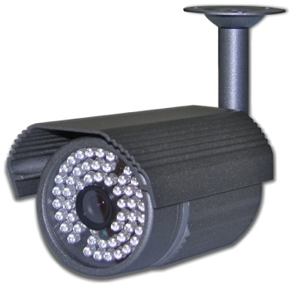
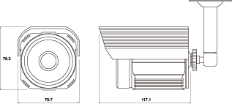
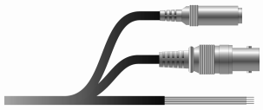
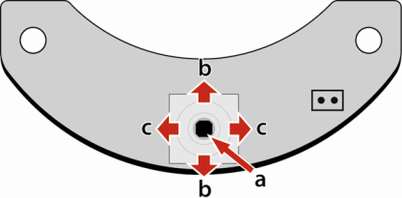
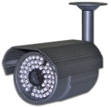

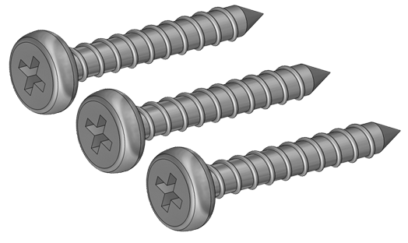
PRECAUTIONS
NAME OF EACH PART
DIMENSION
• Do not install the camera in extreme temperature conditions.
- Only use the camera under conditions where temperatures are between -10°Cand +50°C. Be especially careful to provide ventilation when operating under high temperatures.
• Do not install or use the camera in an environment where the humidity is high.
- It can cause the image quality to be poor.
• Do not install the camera under unstable lighting conditions.
- Severe lighting change or flicker can cause the camera to work improperly.
• Never use the camera close to a gas or oil leak.
- It can cause malfunctions to occur.
• Do not disassemble the camera.
- There are no user-serviceable parts inside it.
• Do not touch the front lens of the camera.
- It is one of the most important parts of the camera. Be careful not to be stained by fingerprint.
• Never keep the camera face to strong light directly.
- It can damage the image sensor.
• Do not drop the camera or subject them to physical shocks.
- It can cause malfunctions to occur.
• Do not expose the camera to rain or spill beverage on it.
- If it gets wet, wipe it dry immediately. Liquids can contain minerals that corrode the electronic components.
• Do not expose the camera to radioactivity.
- If exposed to radioactivity the image sensor will fail.
* NOTE *
• If the camera is exposed to spotlight or object reflecting strong light, smear or blooming may occur.
• Please check that the power satisfies the normal specification before connecting the camera.
Bracket
Sunshield
Lens
IR LED
Sensor
CABLE CONNECTION
Power input (DC 12V)
HD-SDI output
Red : RS-485+ / Yellow : RS-485-
White : Motion output / Black : GND
(Option)
OSD CONTROL (Option- BOARD / CABLE)
Video loop-out
a
UP
L
DOWN
R
OSD Controller
COMPOSITION
a. SET :
Displays the menu on the screen. Press this switch to confirm status or after changing a selected item.
b. UP / DOWN :
Used to move the cursor up or down in the menu screen to select a desired menu item.
c. LEFT / RIGHT :
Used to move the cursor left or right in the menu screen or to change the value of the selected item.
Camera
HD-SDI cable
Power cable
RS-485 cable
(Option)
Screw
Manual

